Slide 1

Black Mental Health and Wellbeing Alliance
October 2024
Notes:
Intro notes:
We will present then Q&A
We will be recording, can switch off camera if they want

Slide 2
How it was developed and who is involved?
The Black Mental Health and Wellbeing Alliance is a collective of individuals working in the mental health sector in England, with a deep-rooted interest in addressing racial inequalities that impact Black people disproportionately.
This includes experts by experience, carers, practitioners, researchers, community organisations, national charities and more.
As an Alliance, we have passionately spearheaded the Black Mental Health Manifesto in order to inform and influence national policy and practice.
Notes:
Reviewed recommendation from the decades to see what has been fulfilled and what hasn’t
What's in the direction of travel, what more can be added to reflect where we are now while holding the future in mind

Slide 3

Notes:
Over 35 orgs

Slide 4
Black people’s mental health

Slide 5
Black people are more likely to experience a common mental health problem (NHS Digital, 2016)
Higher rate of PTSD, suicide risk, and more likely to be diagnosed with schizophrenia (Khan et al, 2017)
Black ethnic groups had a lower rate of treatment completion (3.8%) for Talking Therapies (NHS Digital, 2023)
Black people 3.6 x more likely to be detained under the Mental Health Act (NHS Digital, 2024)

Slide 6
Racial inequalities in young people’s mental health
Overall, the data on the mental health needs of children and young people from racialised backgrounds and their families is poor and patchy.
Data from NHS finds that Black, Asian and Minority Ethnic communities were least likely to present with diagnosable difficulties between the ages of 5 and 19 years (NHS Digital, 2017).
Notes:
The evidence is clear that race and ethnicity are not known risk factors for poor mental health (Synergi Collaborative, 2017), which points to racism, not race, as an undeniable factor in these disparities. It cannot be understated that racism is a public health crisis.

Slide 7
A crisis-driven response?
Black and mixed-race children accounted for 36% of young people detained in acute mental health services in 2021 despite making up 11% of the population based on unpublished data from NHS Benchmarking.
Conversely, young Black people made up a small proportion (just 5%) of those accessing community-based child and adolescent mental health services (CAMHS) (The Independent, 2022).
Children and young people from racialised backgrounds are twice as likely to access mental health support via court orders such social care or criminal justice related orders (Anna Freud Centre & UCL, 2019)

Slide 8
Race and ethnicity are not known risk factors for poor mental health
(Synergi Collaborative, 2017)
Notes:
The evidence is clear that race and ethnicity are not known risk factors for poor mental health (Synergi Collaborative, 2017), which points to racism, not race, as an undeniable factor in these disparities. It cannot be understated that racism is a public health crisis.

Slide 9
The impact of racism on young people’s mental health:
Young Black people’s mental health has faced a succession of harms from:
the disproportionate effects of Covid and the cost-of-living crisis
the murder of George Floyd and vicarious trauma
and more recently, the racist and Islamophobic riots across the UK in the summer of 2024.

Slide 10
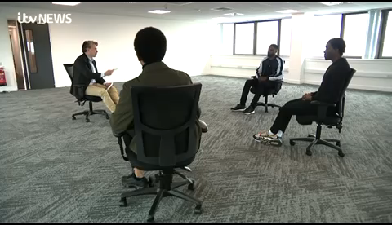
Shifting the Dial: ITV interview
Notes:
https://www.itv.com/news/central/2021-05-07/i-knew-it-would-have-a-positive-impact-the-group-supporting-young-black-men-with-their-mental-health

Slide 11

The Young Changemakers programme provided the space for young Black people to co-create the solutions to these problems, for example by addressing hair discrimination, tackling racist micro-aggressions in schools and boosting cultural awareness for GPs.
WE’RE CALLING FOR:
Government to tackle racism through a comprehensive cross-government strategy
Decision-makers to engage young Black people in coproducing solutions to young people’s mental health problems
Mental health services to offer culturally competent support with professionals from the same communities
Ensure the new generation of open-access mental health hubs for young people promised in the Government’s manifesto are designed jointly with young people from racialised communities locally.
Notes:
The evidence is clear that race and ethnicity are not known risk factors for poor mental health (Synergi Collaborative, 2017), which points to racism, not race, as an undeniable factor in these disparities. It cannot be understated that racism is a public health crisis.

Slide 12
Black people’s mental health: Addressing the structural drivers

Slide 13
The UK government must appoint a Minister for Racial equality with clear accountability for Black people’s mental health and develop a comprehensive plan to tackle racism.
2. The UK government must work with Black communities to develop fully funded, non-medical mental health solutions, like social prescribing, and fund community-led suicide prevention initiatives.
3. The UK government must end all migration policies that negatively impact the mental health of refugees, asylum seekers and migrants. The UK government must compensate Windrush scandal survivors including appropriate mental health support for them and their families.
4. The Government should empower all local Integrated Care Systems to prioritise eradicating health inequalities facing Black communities in access, experience and outcomes through their strategy and implementation plans.
Notes:
National Healthcare Inequalities Improvement Program
1: race equality act, someone needs to over see this
2. The London Social Prescribing Map
4: Prioritising Black-Led Organisations:.Co-Designing Programs: Capacity Building: Provide technical support and knowledge transfer to Black-led organisations to strengthen their operational capacity and long-term sustainability.Flexible Funding: Offer flexible funding models that allow Black-led organisations to innovate and adapt to the specific needs of their communities.Equitable Partnerships:
5. Mandate Health Equity Goals, incentivise Funding for Inclusive Initiatives, Strengthen Data Collection and Accountability, Establish National Oversight and Reporting, Integrate Health Inequalities in Performance Metrics

Slide 14
Improving ways of working

Slide 15
All NHS Trusts, VCSE and mental health service providers must fully resource and embed NHS England’s Patient and carer race equality framework (PCREF).
Those in charge of commissioning services at a national and local level must share decision making power and increase resources to Black-led organisations, and all decision-making boards in key institutions like the NHS must reflect the people their decisions impact.
The UK government must invest in community research and give it as much priority as other research when developing policies for Black people.
4. The UK government must urgently reform the Mental Health Act, which hugely disproportionately impacts Black people.
Notes:
If this approach is designed, implemented and consistently evaluated meaningfully, then it should also support us in meeting the following:
CQC has integrated evidence of PCREF into our assessment framework, detailed guidance for our inspectors will be coming)
15. Statutory and non-statutory regulators, bodies and organisations such as the CQC, ICBs, Equality and Human Rights Commission and NICE must have policies and strategies that are explicit about anti-racist practice and undertake audits to ensure accountability.

Slide 16
Reimagining mental health support

Slide 17
We want a world in which every Black person who wants to work with a Black therapist has that option.
2. We want a world in which resources are for law enforcement are re-distributed to communities.
3. We want a world in which the education system is actively anti-racist and empowers Black children and young people
Notes:
2: Funding traditionally allocated to policing can be redirected to support community-based initiatives, such as mental health services, education, housing, and social programs. This shift would empower communities to address the root causes of inequality and crime through proactive, rather than reactive, measures.

Slide 18
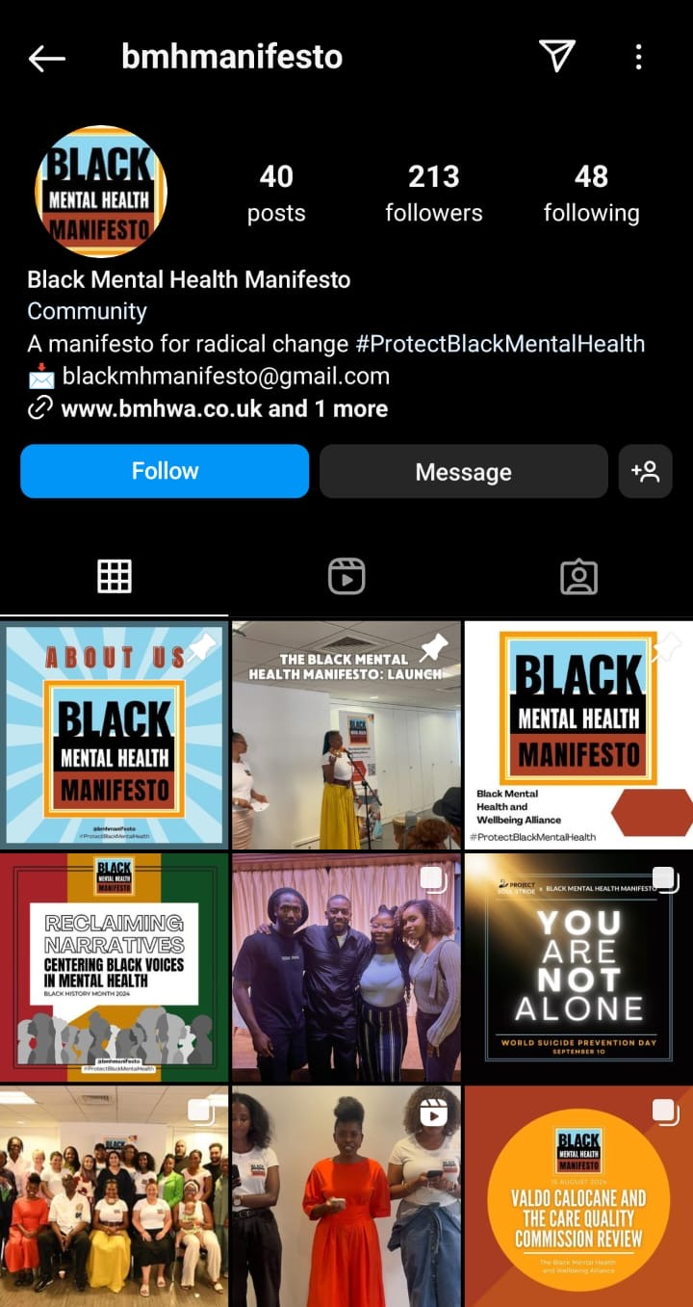
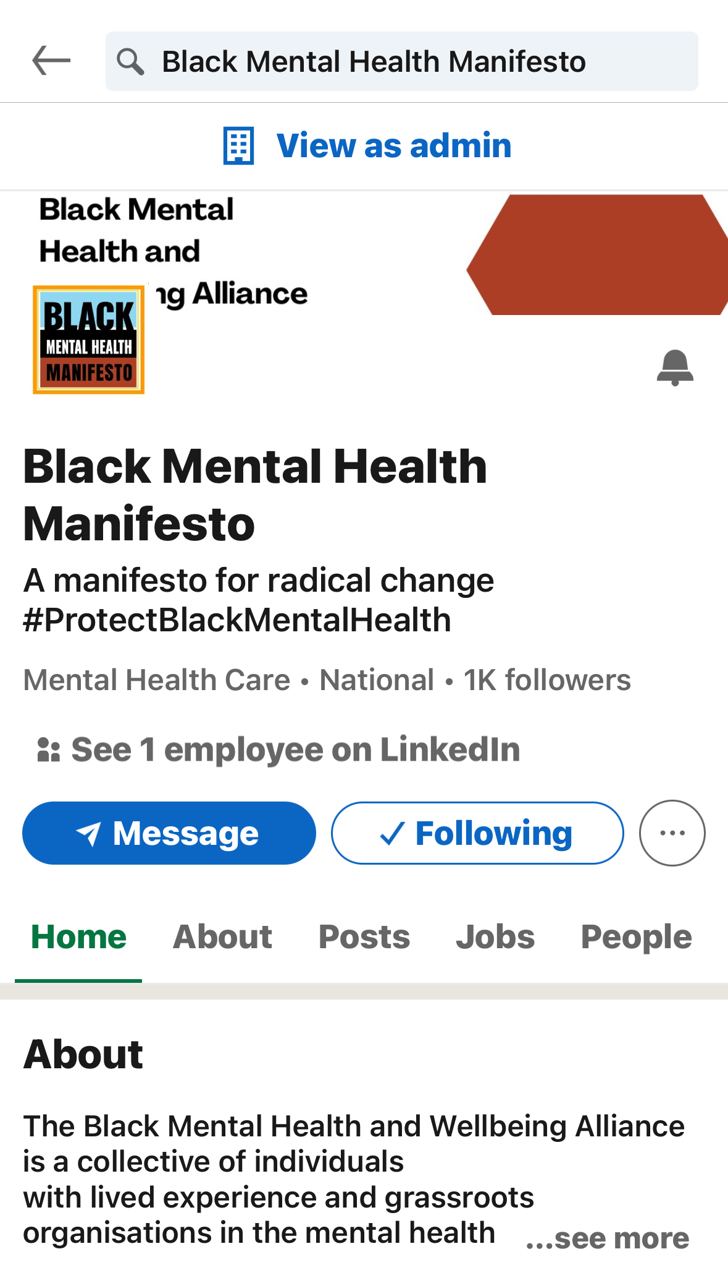
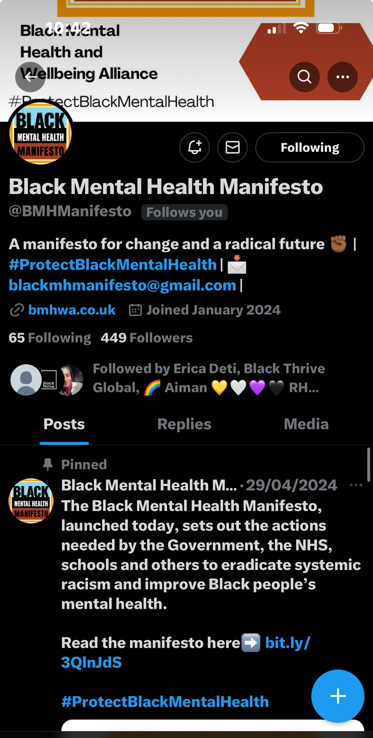

Slide 19
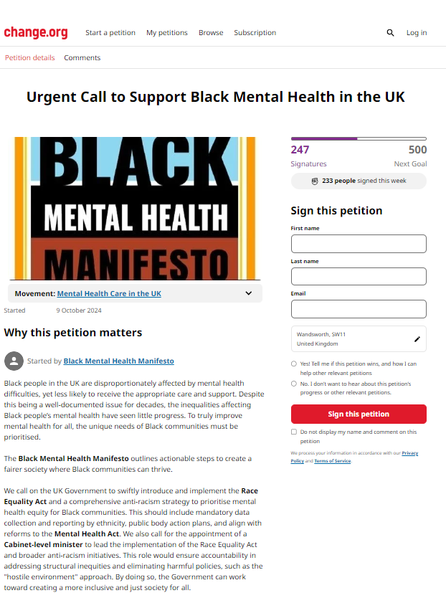

Show your support, sign our petition!

Slide 20
Joden’s journey

Slide 21
Key considerations when supporting young Black people:
Holding some expertise, whilst promoting agency in others
Reflective practice
Embracing authenticity
Cultivating understanding and awareness about contextual challenges
Decentring yourself
Practicing active listening
Recognising and redistributing power and privilege

Slide 22
Key considerations when supporting young Black people:
Discuss repair and rupture
Promoting safety
Building trust through relational approaches
Ensuring confidentiality and transparency
Balancing consistency and structure with flexibility
Deepening understanding and empathy
Adopting a contextual safeguarding approach
Dynamic risk assessments

Slide 23
Key considerations when supporting young Black people:
Attune to colloquialism and idioms of distress whilst remaining authentic
Incorporating creative methods to encourage expression
Avoid hegemonic assumptions
Respecting the role of faith and spirituality
Mindful about intersectionality

Slide 24
Q&A

Slide 25





Black Mental Health and Wellbeing Alliance
A Manifesto for Radical Change
October 2024
Blackmhmanifesto@gmail.com
www.bmhwa.co.uk
linkedin/blackmhmanifesto
@BMHManifesto

